Slide 1

Optimal Distribution of Electric Vehicles Charging Stations
Presented by Haoting Ge, Noah Garfinkle, and Ximi Qu for CEE 512: Logistics Systems Analysis
Presented on 21 October 2019

Slide 2
Motivation and Academic Significance
Freight delivery via semi-trucks is the foundation of many logistic networks in the United States.
Semi-trucks emit 16 percent of corporate greenhouse gasses and pose substantial fuel costs for logistics systems. [1]
Electric semi-trucks are now entering the market, with some countries specifying ambitious targets to replace all trucks with electric vehicles. [1]
Differing ‘refueling’ requirements of electric vs. diesel semi-trucks may require modification of routing timetables to enable charging.
Background
Objective
Problem Formulation
Results
Haoting Ge, Noah Garfinkle, and Ximi Qu | CEE 512: Logistics Systems Analysis | Slide 2 of 9

Slide 3
Guiding Philosophy/ Strategy
Show the two approaches side by side
Conduct the strategic decision (facility location) first
Then determine optimal routes and check to see if modifications to strategic decision can enable better routing
Background
Objective
Problem Formulation
Results
Haoting Ge, Noah Garfinkle, and Ximi Qu | CEE 512: Logistics Systems Analysis | Slide 2 of 9

Slide 4
Objective Function

Slide 5
Research Questions
For a specified logistics and routing network:
Where and what type (charging speed) of charging infrastructure should be installed?
How will optimal routes of electric semi-trucks vary from those of the existing (diesel) optimum?
Will electric semi-trucks require additional (excess beyond unload time) time at nodes to recharge?
Background
Objective
Problem Formulation
Results
Haoting Ge, Noah Garfinkle, and Ximi Qu | CEE 512: Logistics Systems Analysis | Slide 3 of 9

Slide 6
Problem Formulation: Objective Function
This research will investigate the trade-offs between:
Route efficiency
Cost of installation and operation of new recharging infrastructure
Charging time for a hypothetical logistics system network
Background
Objective
Problem Formulation
Results
Haoting Ge, Noah Garfinkle, and Ximi Qu | CEE 512: Logistics Systems Analysis | Slide 4 of 9

Slide 7



Problem Formulation
Links:
Distance
Trucks:
Fixed:
Capacity
Range/ travel time (?)
Charging Rate Function
Decision
Route
Capacity (?)
Type of truck (?)
Nodes (each depot):
Fixed:
Demand
Loading time
Capacity (number of trucks)
Decision:
Charging capacity and voltage (charging speed)
Time spent charging
Warehouse
$$Depot_{1}$$
$$Depot_{i}$$
$$Depot_{2}$$

Slide 8
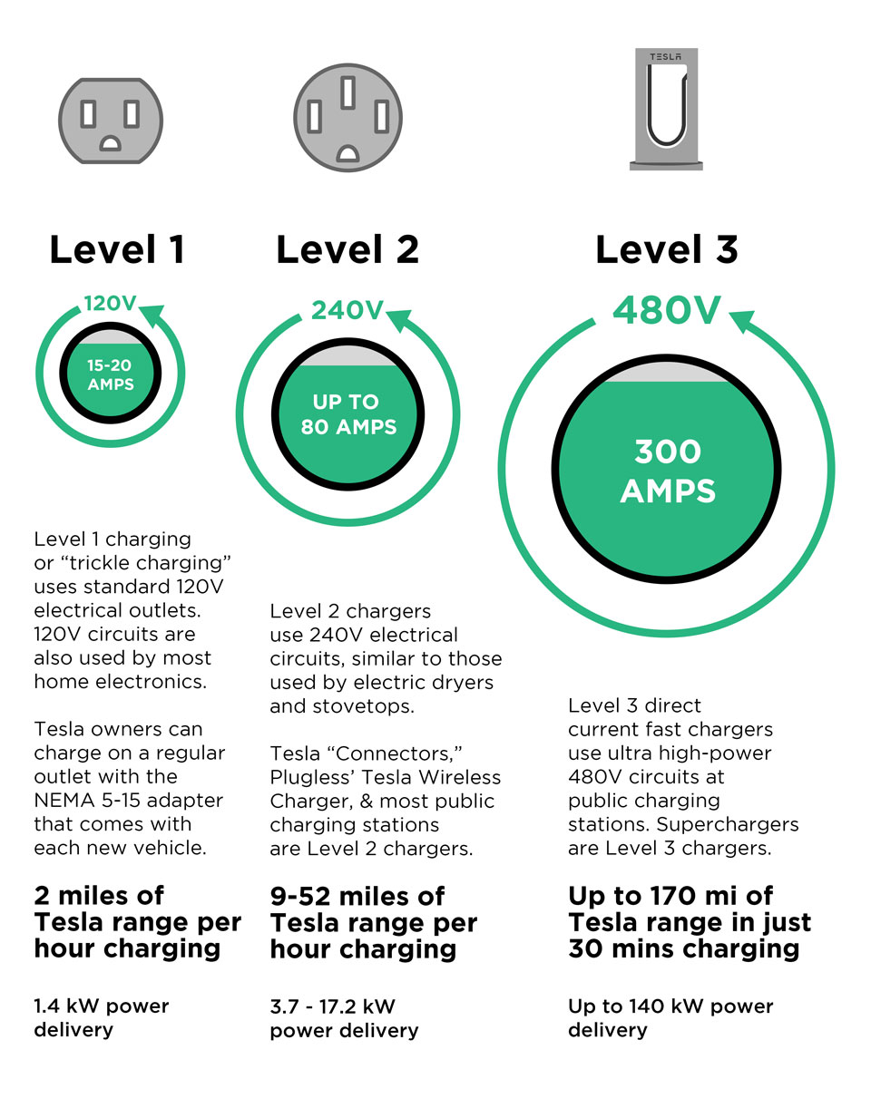
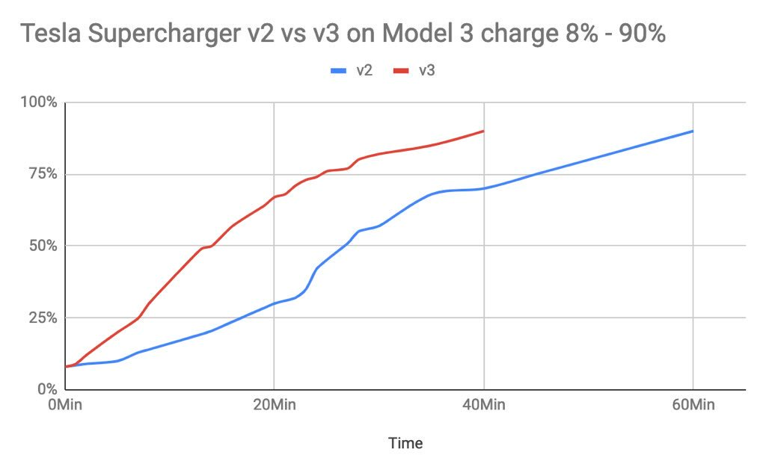
Problem Formulation: Vehicle and Charging Characteristics
Will select at least one model of electric semi-truck with consideration for charging rate
Three types of charging: https://www.pluglesspower.com/learn/tesla-model-s-charging-home-public-autonomously/
https://www.pluglesspower.com/learn/tesla-model-s-charging-home-public-autonomously/
Background
Objective
Problem Formulation
Results
Haoting Ge, Noah Garfinkle, and Ximi Qu | CEE 512: Logistics Systems Analysis | Slide 6 of 9

Slide 9
Methodology Exploration
This project will investigate, formulate, and implement:
A construction algorithm
A segmentation heuristic to subdivide the VRP into TSP Tours
A construction heuristic to generate feasible seed candidate solutions
For instance: Ring-sweep algorithm, location-based approach, or other approach as identified in course study
A metaheuristic to explore improvements to seed solutions
For instance: Tabu search, genetic algorithm, or other approach as identified in course study
The evaluation criteria will be formulated per the objective function.
Background
Objective
Problem Formulation
Results
Haoting Ge, Noah Garfinkle, and Ximi Qu | CEE 512: Logistics Systems Analysis | Slide 7 of 9

Slide 10
Anticipated Results
The project is expected to deliver:
An initial progress report
A combined routing and charging model formulated as an objective function and optimization approach
A final presentation
A final report
Any progress reports or presentations as required
Background
Objective
Problem Formulation
Results
Haoting Ge, Noah Garfinkle, and Ximi Qu | CEE 512: Logistics Systems Analysis | Slide 8 of 9

Slide 11
References
[1] https://missionfinancialservices.net/fully-electric-semi-trucks-the-future-of-trucking/
[2] He, Fang, et al. "Optimal deployment of public charging stations for plug-in hybrid electric vehicles." Transportation Research Part B: Methodological 47 (2013): 87-91.
[3] The Location Optimization of Electric Vehicle Charging Stations Considering Charging Behavior- Tian, Hou, Gu, Gu, and Yao, 2018 (Simulation)
[4] Zhang, K., Lu, L., Lei, C., Zhu, H., & Ouyang, Y. (2018). Dynamic operations and pricing of electric unmanned aerial vehicle systems and power networks. Transportation Research Part C: Emerging Technologies, 92, 472-485.
Background
Objective
Problem Formulation
Results
Haoting Ge, Noah Garfinkle, and Ximi Qu | CEE 512: Logistics Systems Analysis | Slide 9 of 9

